Slide 1

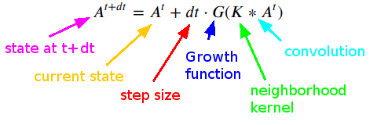
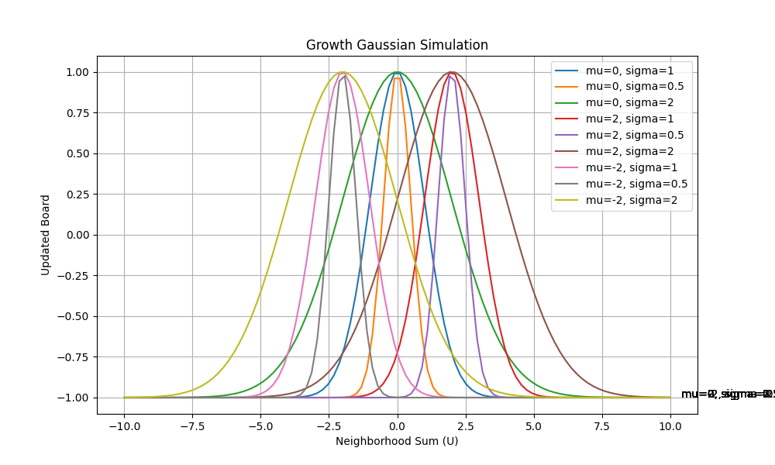

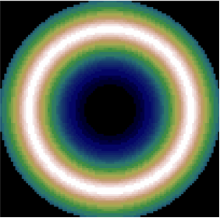
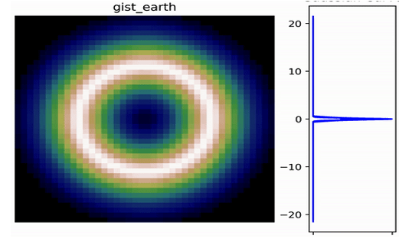
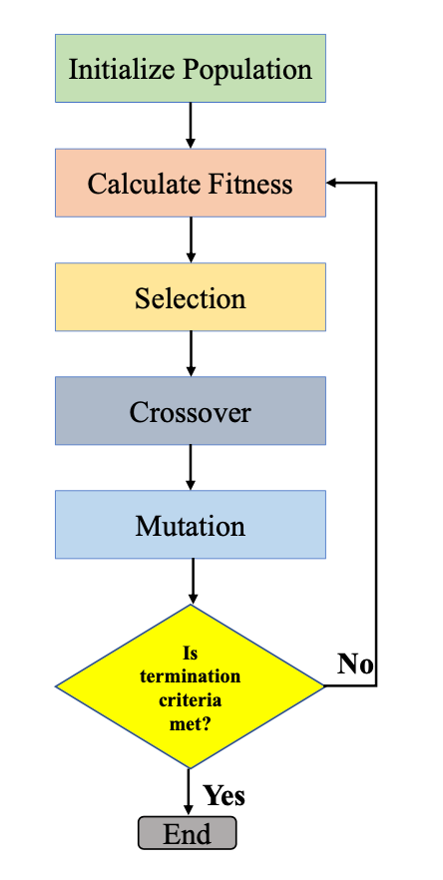
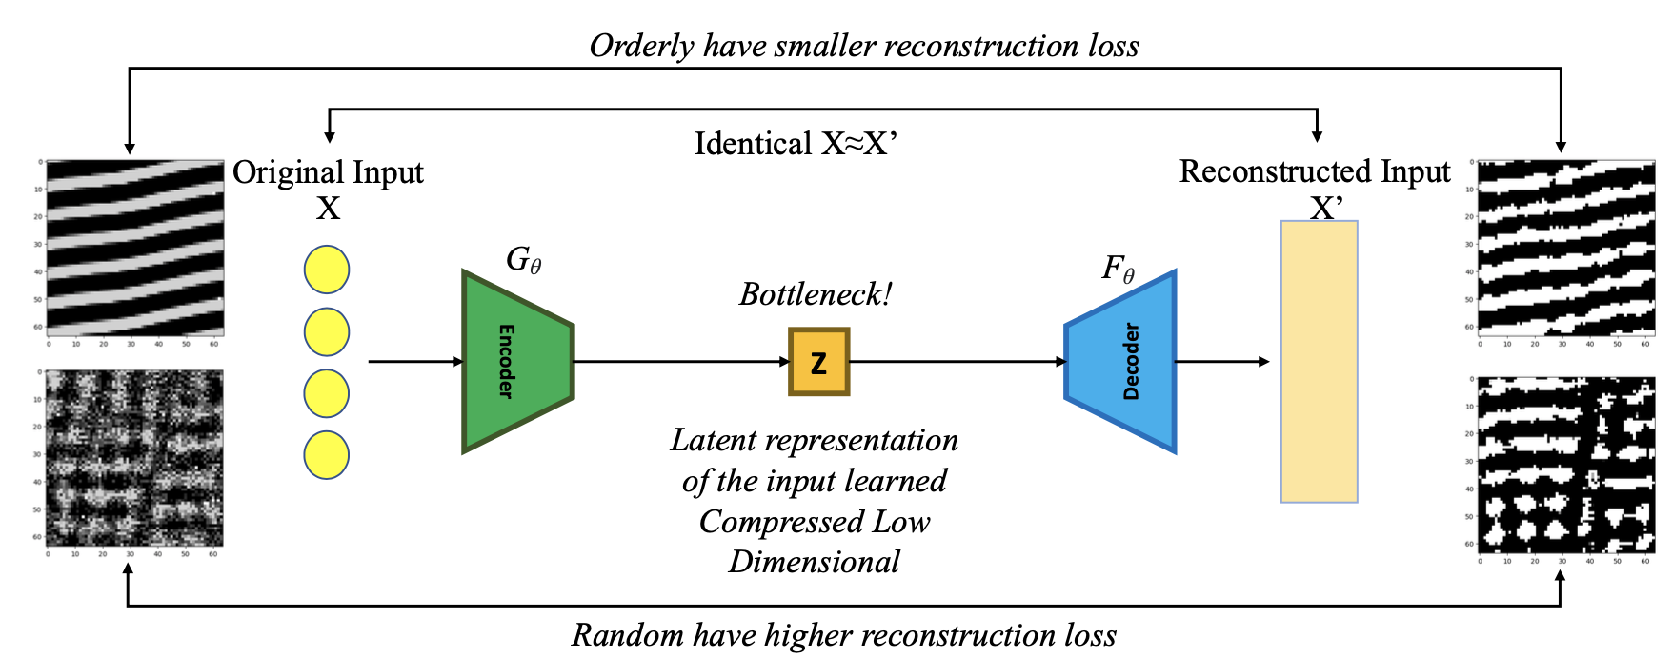
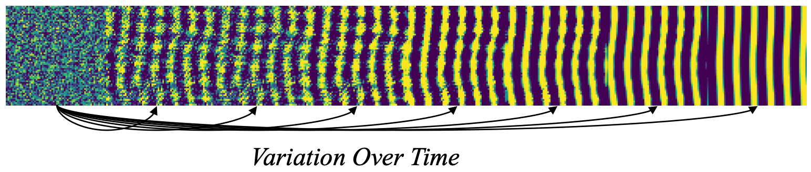



Capturing Emerging Complexity in Lenia
Sanyam Jain, Aarati Shrestha and Stefano Nichele | HiØ, Halden Norway
Motivation
Introduction (1)
Introduction (2)
Complexity, Evolution and AGI
Lenia
Growth Function
Open-Endedness
Auto AI vs AGI
AI Generating Algorithms
Tools to study complex systems, computation, life and evolution.
Measuring long-term complex emerging behavior in Lenia is an open problem.
How AI systems may become more open-ended, adaptive, and general, through the emergence of complex behaviors from simple rules
Lenia is an artificial life where simple rules can give rise to complex behavior in a digital system.
Lenia differs from traditional CA in that its cells are not limited to discrete states like ”on” or ”off”. Instead, each cell can take on a continuous range of values, which allows for more fluid and organic patterns.
Update board
It takes an input array representing the neighborhood sum and uses a Gaussian function to calculate the growth value for each element.
This function provides a smooth and continuous function that gradually changes the board state in a more fluid like manner.
By adjusting the mean and standard deviation parameters of the Gaussian function, each cell’s growth or decay can be precisely controlled allowing wide range of patterns.
AI-Grand Challenges
Automated Discovery: Novelty Search, Quality Diversity, Interactive EC for Morphogenesis
Emergent Agency: Neural CA, Sensorimotor Lenia, Train creatures by backprop, avoid obstacles, eat energy
Swarm Cognition: Evolve collective behaviors & intelligence; Biological levels - organelles, cells, organisms, colonies/societies
Open Endedness: Complexity, emergence of behavior, self-replication, movement etc.
Turing Completeness: Can Lenia perform memory-based operations, logic gates etc.
Kernel Function
Mu = 0.5, sigma=0.15
Smooth and blur
Influence of neighboring pixels
Weighted importance to neighboring pixels and gradually reduced importance to distant pixels.
Convolution operation
Input: distance, mu, sigma
Operation
Find radius, initialize empty mesh grid of coordinates
calculate the distances of each coordinate from the center and apply a mask to filter out values outside the desired radius
Output: Kernel array
🧬
Kernel with varying sigma
Kernel with varying mu
How kernel is developed
Proposed Methods in Evolutionary Lenia : VoT, AE and AEVoT
VoT: Complexity in VoT is roughly estimated by tracking active cell counts on the board, offering insights into system dynamics and trends.
AE: In both VoT and AE, complexity is assessed through encoding the current Lenia board state into a lower-dimensional space and measuring the information lost during reconstruction, with higher loss indicating complexity.
Conclusion
Reproduced Standard Lenia
Setup EC with three fitness: VoT, AE, and AEVoT
We ran 27 standard known configuration experiments
5 known kernel experiments
2 long generation size experiments
Five-fold validation
Discovered a ring forming bacteria
References
[1] K. O. Stanley, J. Lehman, and L. Soros, “Open-endedness: The last grand challenge you’ve never heard of,” While open-endedness could be a force for discovering intelligence, it could also be a component of AI itself, 2017.
[2] K. Gregor and F. Besse, “Self-organizing intelligent matter: A blueprint for an ai generating algorithm,” arXiv preprint arXiv:2101.07627, 2021.
[3] Chan, B. "Lenia: Biology of Artificial Life." Complex Systems 28.3 (2019).
[5] Mordvintsev, A., et al. "Growing neural cellular automata." Distill 5.2 (2020): e23.
[6] Variengien, A., et al. "Towards self-organized control" Innovations in Machine Intelligence (IMI), vol. 1, pp. 1-14 (2021).
[7] Gregor, K., et al. “Self-organizing intelligent matter: A blueprint for an ai generating algorithm”. arXiv preprint arXiv:2101.07627 (2021).
[8] Chan, B. "Lenia and Expanded Universe." ALIFE 2020: The 2020 Conference on Artificial Life. MIT Press, 2020.
[9] Cisneros, H., et al. "Visualizing computation in large-scale cellular automata." ALIFE 2020 proceedings. MIT Press, (2020).
Play with it: https://s4nyam.github.io/evolenia
/s4nyam
Lab Details: https://www.nichele.eu/lab.html
/s4nyam

